Slide 1
False Discovery Rate in Large Multiplicity Problems
Yoav Benjamini
Tel Aviv University
www.math.tau.ac.il/~ybenja
Copyright, 1996 © Dale Carnegie & Associates, Inc.

Slide 2
Organization of the talk
Motivating Examples
The general thresholding problem
FDR controlling procedures and their properties
Use of FDR in High Throughput Screening
Use of FDR in Data Mining
Concluding Remarks

Slide 3
Based on joint work with
Yosi Hochberg
Daniel Yekutieli
Felix Abramovich
Anat Reiner
Dave Donoho
Iain Johnstone
Abba Krieger
Frank Bretz

Slide 4
Motivating Examples
High throughput screening
  Of Chemical compounds
  Of gene expression
Data Mining
  Mining of Association Rules
  Model Selection

Slide 5
High throughput screening of Chemical Compounds
Purpose: at early stages of drug development, screen a large number of potential chemical compounds, in order to find any interaction with a given class of compounds (a "hit" )
The classes may be substructures of libraries of compounds involving up to 10⁵ members.
Each potential compound interaction with class member is tested once and only once

Slide 6
High Throughput Screening with Microtiters
i=74
j=1
plate i
row j
i=1
j=8
Negative control
Positive control
k=2
k=11
10x8 Potential Compounds

Slide 7
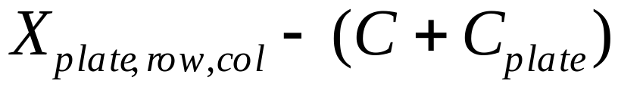
High Throughput Screening
Step 1: Analyzing the negative control data
74 plates x 8 rows
Get comparison values per plate and s.e.
Step 2: Conduct individual comparisons
74 plates x 80 potential compounds
Note positive dependency
within plate because of

Slide 8
Gene-expression micro-arrays
Example: Dudoit et al (2000):
Statistical analysis of a lipid metabolism study in mice.
Treatment: 8 low HDL level knockout mice
Control: 8 inbred mice
Purpose: Identification of single differentially expressed genes in replicated cDNA microarray experiments.

Slide 9
Microarrays and their Statistical Analysis
The microarray data consisted in this case of 6359 individual DNA sequences (out of 6384 printed in a high density array on a glass).
Both treatment and control on a single chip
The ratio of the fluorescence intensity measured for each spot in the array is indicative of the relative abundance of the corresponding DNA sequence in the two nucleic acid samples.
Data was suitably standardized using lowess smoother.
A t-statistic is calculated for comparing the mean of each gene expression in the control and treatment groups.

Slide 10
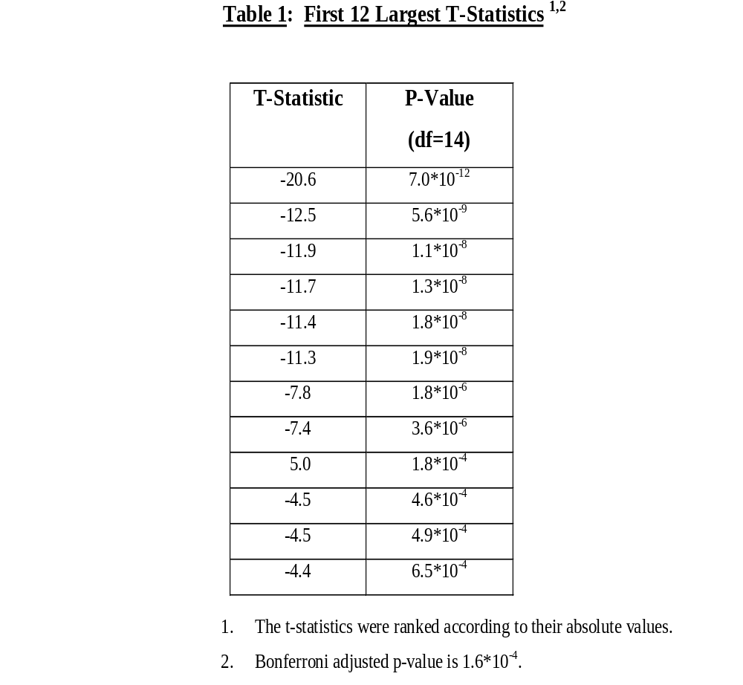
Microarrays and Multiplicity
Neglecting multiplicity issues, i.e. working at the individual 0.05 level, would identify, on the average, 6359*0.05=318 differentially expressed genes, even if really no such gene exists.
Addressing multiplicity with Bonferroni at 0.05 identifies 8 .

Slide 11
Mining of association rules in Basket Analysis
A basket bought at the food store consists of:
(Apples, Bread,Coke,Milk,Tissues)
Data on all baskets is available (through cash registers)
The goal: Discover association rules of the form
Bread&Milk => Coke&Tissue
Also called linkage analysis or item analysis

Slide 12
Properties of association rules
The support of the rule is the
Proportion of baskets with Bread&Milk&Coke&Tissue
The confidence of the rule is the
Sup (Bread&Milk&Coke&Tissue)/Sup(Bread&Milk)
(simply the estimated conditional probability in statistical terms)
The lift of the rule is the
Sup (B&M&C&T)/Sup(B&M)Sup(C&T)
Search for rules with high confidence and support

Slide 13
More on Association Rules
Will the results be affected by randomness?
Add the requirement that the rule is statistically significant in the test against independence (i.e. against lift=1)
The number of such tests to be performed in a moderate problem reaches tens of thousands

Slide 14
Model Selection
Paralyzed veterans of America
Mailing list of 3.5 M potential donors
200K made their last donation 1-2 years ago
Is there something better than mailing all 200K?
If all mailed, net donation is $10,500
Using data mining...

Slide 15
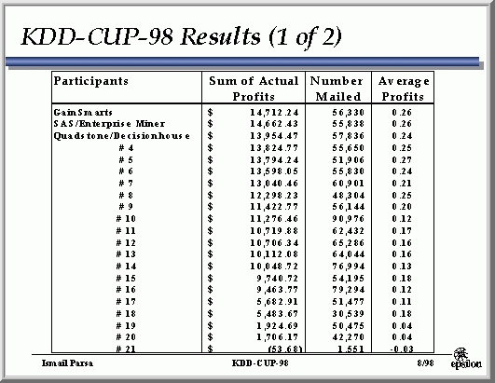

Slide 16
Model Selection
The winning performer GainSmart (by Yaacov Zehavi) used logistic regression to model the prob. of response for each individual
Some 300 variables to be considered for the model - more when transformations were considered
Which variables should be included in the model?
(Foster and Stein’s model personal bankruptcy using 200 original variables plus all 200x200 variables capturing interactions)

Slide 17

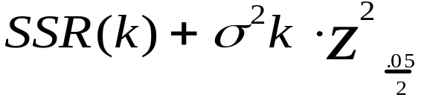

Model Selection in large problems
known approaches to model selection
  AIC and Cp
  .05 in testing “forward selection” or “backward elimination
  The Universal Threshold of Donoho and Johnstone

Slide 18
Other examples
Genetics: mapping (Hsu’s talk, but instead of 63 markers 800-2000; instead of 1 gene a few; instead of 1 endpoint a few.)
Behavioral genetics
Functional MRI
Image processing and wavelets analysis
Multiple endpoints in medical studies

Slide 19
What’s in common?
Size of the problem: large to huge
(m small n large ;m=n large; m large n small)
Question 1: Is there a real effect at a specific gene/site/location/association rule?
Question 2: If there is an effect, of what size?
Discoveries are further studied; negative results are usually ignored
Results should be communicated compactly to a wide audience
A threshold is being used for question 1.

Slide 20
The setting of a threshold
Gene expression
  “practical”
Chemistry
  “no hypotheses testing, just look and consider”
Functional MRI
  “practical” adjusted to the individual at test
Association Rule
  Unadjusted tests
How should a threshold be chosen?

Slide 21
Significance testing as thresholding
The problem is closest to classical significance testing, possibly followed by estimation.
We should worry about multiplicity!
What error-rate to control?

Slide 22
Chalenges
Controlling the FWE is too restrictive
  There is almost always at least one “real” effect
  Not important to protect against even a single error
  Why should a researcher be penalized for conducting a more informative study?
Not controlling for multiplicity:

Slide 23
“guidelines for interpreting…” Lander and Kruglyak ‘95
“Adopting too lax a standard guarantees a burgeoning literature of false positive linkage claims, each with its own symbol… Scientific disciplines erode their credibility when substantial proportion of claims cannot be replicated…”
….i.e.
when the False Discovery Rate was too high!
They suggested control of FWE instead, but are ready to live with level .5 (half!), to overcome loss of power.

Slide 24
So, we suggest,
use FDR hypotheses testing to set the threshold
Multiplicity can no longer be ignored
Not by Frequentists nor by Bayesians
Not because of skepticism, but because it is a better way
    to deal with uncertainty in large data sets
    to summarize the data
See theoretical support later on.

Slide 25
Historical perspective
Tukey, when expressing support for the use of FDR, points back to his own (1953) as the roots of the idea!(?) He clearly was looking over these years for some approach in between the too soft PCE and the too harsh FWE.

Slide 26
Next, how do we infer on the selected set ?
Hypotheses testing followed by estimation
(point and/or confidence intervals)
In short “Testimation with confidence”

Slide 27
How does it work? Does it makes sense?
Before doing that
One more comment about the FDR criterion
Two comments on the Linear StepUp procedure
Other FDR controlling procedures

Slide 28
The comment about FDR criterion
With all respect to the other TLAs we have seen these past days, FDR is a catchy name
not because of our inventiveness

Slide 29
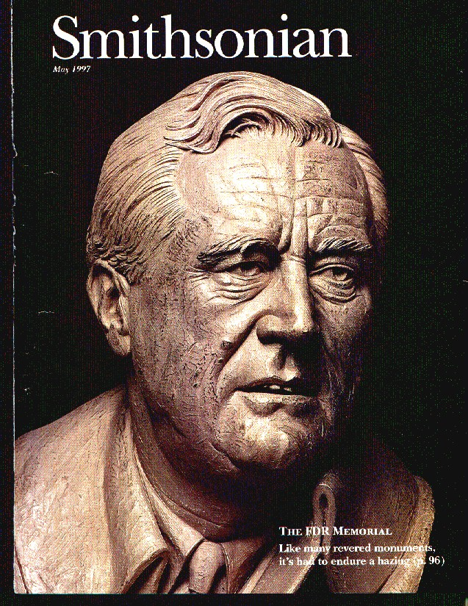

Slide 30
As a result:
  Genovese and Wasserman emphasize the sample quantity V/R
  Storey emphasizes E(V/R | R>0)
  But both keep the term FDR for their versions

Slide 31
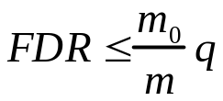
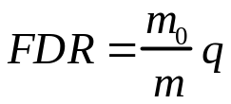
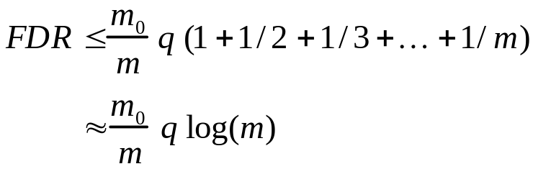
1. Properties of the Linear StepUp Procedure
If the test statistics are :
  Independent YB&Yekutieli (‘01)
  independent and continuous YB&Hochberg (‘95)
  Positive dependent YB&Yekutieli (‘01)
  General YB&Yekutieli (‘01)

Slide 32
Positive dependency
Positive Regression Dependency on the subset of true null hypotheses:
If the test statistics are X=(X₁,X₂,…,X_{m}):
  For any increasing set D, and H_{0i} true
  Prob( X in D | X_{i}=s ) is increasing in s
Important Examples
  Multivariate Normal with positive correlation
  Absolute Studentized independent normal
  (Studentized PRDS distribution, for q<.5)

Slide 33
More about dependency
If the test statistics are :
  All Pairwise Comparisons: x_{i} - x_{j} i,j=1,2,…k
  even though correlations between pairs of comparisons
  are both + and -
  Based on many simulation studies:
    Williams, Jones, & Tukey (‘94,’99); YB, Hochberg, & Kling (‘94+)
    Kesselman, Cribbie, &Holland (‘99).
  And limited theoretical evidence
    Yekutieli (‘99+)
  so the theoretical problem is still open...

Slide 34
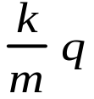
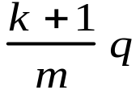
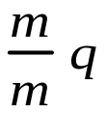
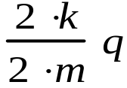
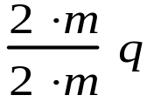
2. Scalability
The procedure is stable as the size of the problem increases.
The discoveries in the combined study are (about) the same as when analyzed separately.

Slide 35
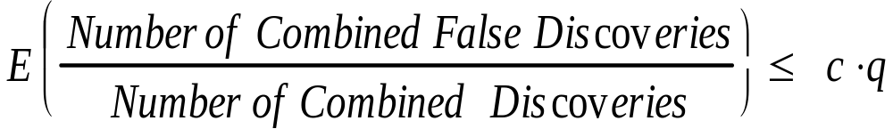
Scalability (cont’d)
For scalability to hold:
  Sub-studies should be large
  Not totally null
Theorem (Abramovich, YB, Donoho, & Johnston (‘98+)):
Using the linear step-up procedure to test L families of hypotheses separately,each family of size m_{i}, and if in each family m_{0i} hypotheses are true, m_{0i} / m_{i} approaching some c<1 as m_{i} increases to infinity,

Slide 36
3. Adaptive procedures that control FDR
Recall the m₀/m factor of conservativeness
Hence: if m₀ is known using linear step-up procedure with qi/ m(m/m₀) = qi/ m₀ controls the FDR at level q exactly.
The adaptive procedure BY & Hochberg (‘00):
  Estimate m₀ from the uniform q-q plot of the p-values
This is FDR controlling under independence (via simulations)

Slide 37
The two-staged procedure
  BY, Krieger, Yekutieli(‘00)
  Use the linear step-up at level q once and get r₁.
  Estimate m₀ (somewhat conservatively) by (m- r₁)/(1-q)
  Use the linear step-up the second time at level q₂= q(1-q)m/ (m- r₁)
The FDR is proved to be controlled at level q in the independent case
The FDR is conjectured to be controlled at level q for positive dependent test statistics (PRDS)
  Proof for m=3
  Simulations for constant positive correlations

Slide 38
Non-parametric step-down procedure
BY &Liu (‘00+)
Discussed by Sarkar
Resampling procedure
Yekutieli &BY (‘99)
Demonstrated later

Slide 39
Organization of the talk
Motivating Examples
The general thresholding problem
FDR controlling procedures and their properties
Use of FDR in High Throughput Screening
Use of FDR in Data Mining
Concluding Remarks

Slide 40
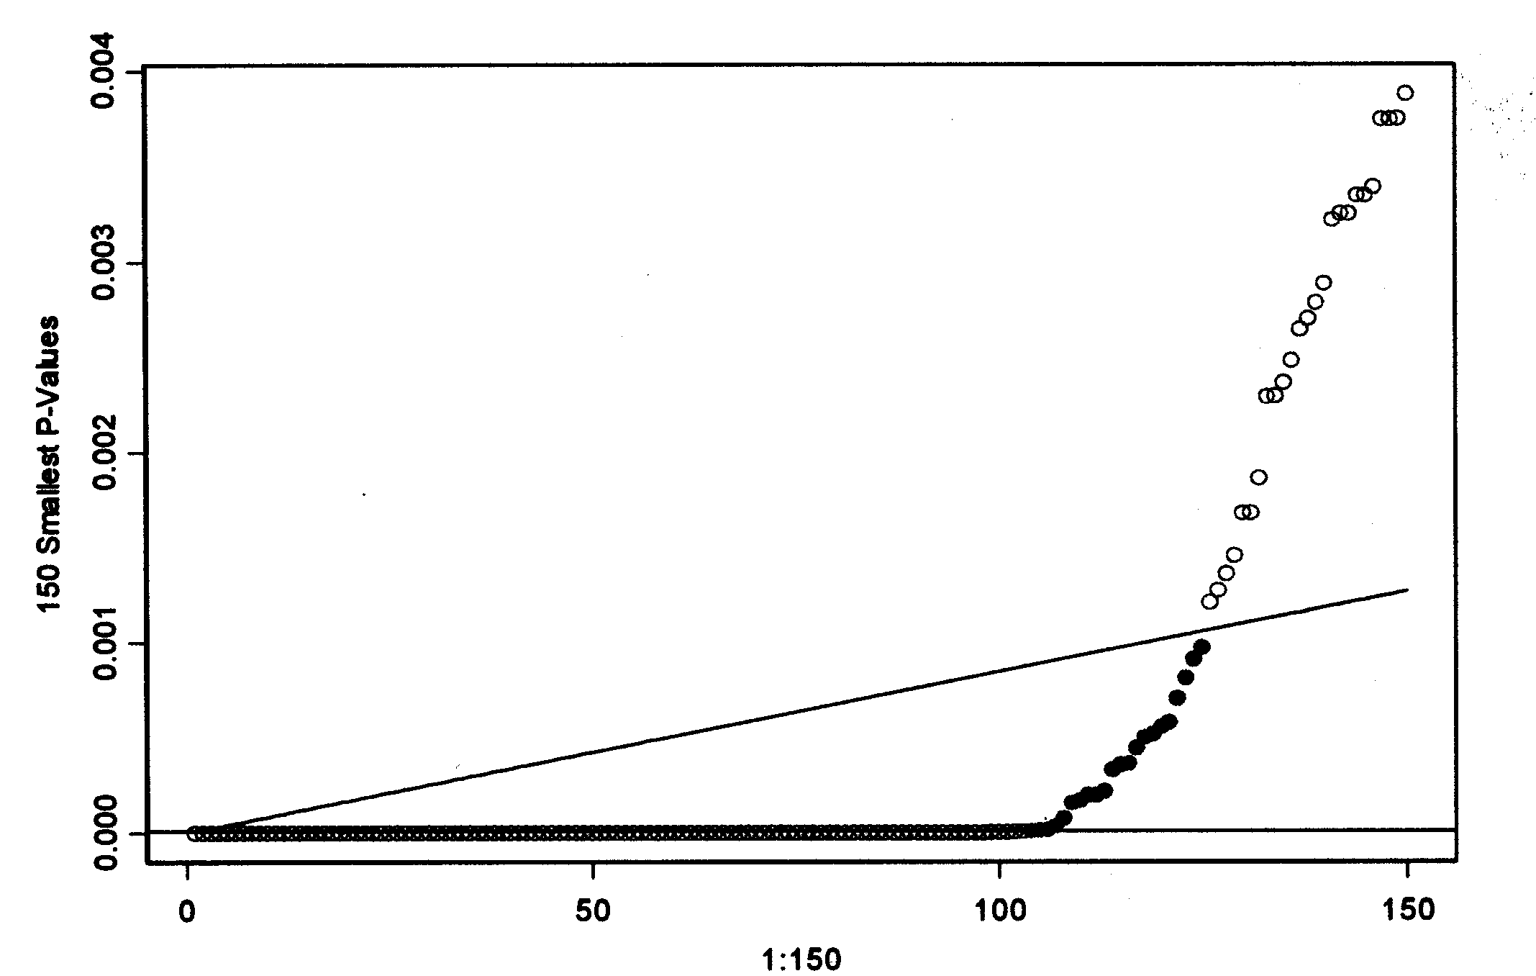
FDR screening of chemical compounds
Uniform q-q plot of test results
zooming into the smallest 150 p-values(largest 150 interactions)
Applying multiple testing at level .05:
FWE control 103 significant (using Bonferroni)
FDR control 125 significant (using Linear StepUp)
Jointly Separately
121
134

Slide 41
FDR in Micro-arrays
Dudoit et al account for multiple testing, by using the Westfall and Young step-down resampling algorithm to calculate adjusted p-values while controlling the FWE.
(avoiding t-distribution assumption and utilizing correlation)
FDR considered (but not used) because of dependency
This need not be a limitation

Slide 42
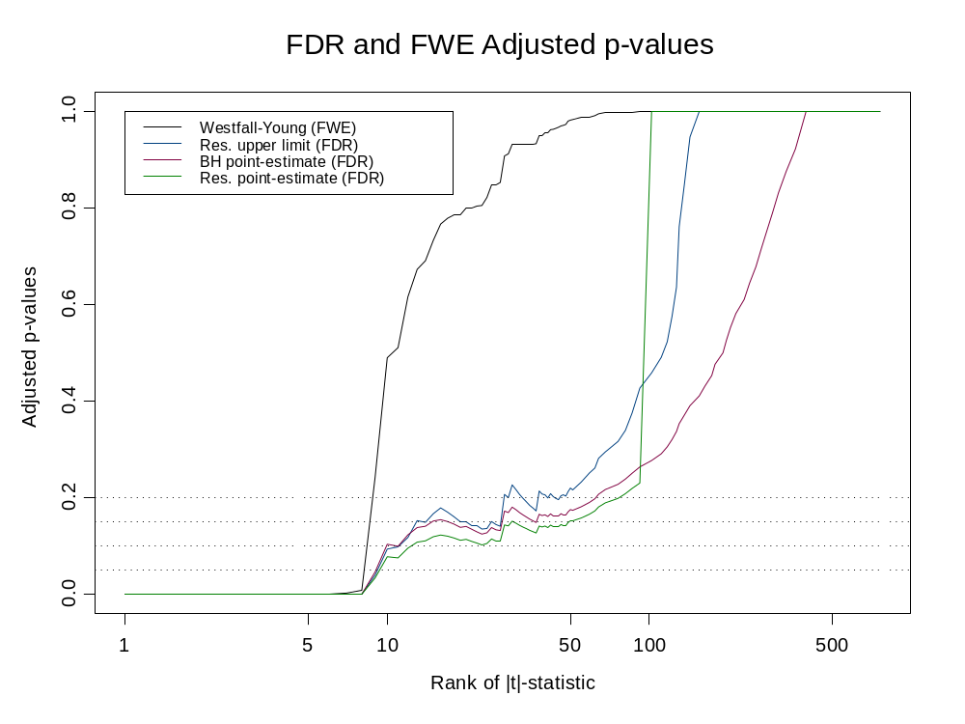

Slide 43
FDR in High Throughput Screening
Particular Remarks (I)
Positive dependency does not harm in both examples, but has been utilized only in the analysis of Micro-arrays
In the chemical example there is constant positive dependency within plate.
We plan to use new FDR controlling procedures for this setting (with F. Bretz)

Slide 44
FDR in High Throughput Screening
General Remarks
An interpretation of FDR:
expenses wasted chasing “red herrings”
expenses made on follow-up studies
Exp(
)≤q
But FDR with 0.2 ???

Slide 45
FDR in High Throughput Screening
FDR with 0.2 ???
Makes sense in screening experiments
which are followed by an independent study
Second study can be conducted on the set of identified genes, (FWE) controlling for multiplicity at, say, .05 / 0.2 =.25 (!).
still the overall (FWE) level is .05.

Slide 46
Inference on the selected set: testimation with confidence
Test using linear step-up procedure
p_{(k)} ≤ qk/m
Estimate using
X_{k}^{FDR} =0 if | X_{k} | < σZ _{qk/2m} (ignore)
=X_{k} if | X_{k} | ≥ σZ _{qk/2m} (report)
amounting to hard thresholding
set confidence intervals
If X_{k}^{FDR} ≠ 0 then X_{k}^{FDR} ± σZ _{qk/2m}

Slide 47
What do these confidence intervals do?
Exp(
# among selected intervals covering
# of selected intervals
)≥1-q
But: Once you select a set of most extremes this need not be the case - the selection problem Yosi was talking about. Still, the construction of simultaneous confidence intervals is not the only solution!
Yekutieli (2001)
Big Deal? Do individual CIs to all, and have
# of intervals covering
# of intervals
Exp(
)≥1-q

Slide 48
What about simultaneous confidence intervals? This is a single confidence set (cube) for the entire multivariate parameter
The FDR confidence intervals, for all parameters, were suggested by Tukey (‘94) at a conference at NISS (mentioned in Williams at al, ‘99). Tukey viewed them more as “gauges” for testing, to be supported by simultaneous CI. He tried to reconcile the two.
In the winter of ‘00 (personal talk):
“I certainly had this procedure in mind, and I like what you say it does”

Slide 49
Testimation - some theory
In the independent problem
Consider #( parameters) -> infinity
  If prop( non-zero coefficients) -> 0,
  Or If size of sorted coefficients decays fast, (while the others need not be exactly 0).
  THEN thresholding by FDR testing of the coefficients is adaptively minimax over bodies of sparse signals
  Where performance measured by any loss 0 < p ≤ 2 : #(errors), sum|error|, sum(error)², relative to best “oracle” performance.
  Abramovich, YB, Donoho, & Johnstone (‘00+)

Slide 50
Model Selection and FDR - Theory
In the orthogonal linear regression problem. Consider #( potential variables) -> infinity
  If prop( non-zero coefficients) -> 0,… as before
  Abramovich, YB, Donoho, & Johnstone (‘00+)
Under non orthogonal regression? Non linear? Non Normal?
What about q? We know q should be <.5!
  Should q ->0 slowly (as required in current proof?)
Many open problems, but the direction is clear:

Slide 51
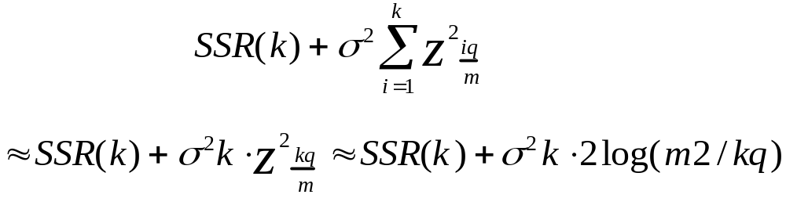


Model Selection and FDR - Practical Theory
The theory is being developed for the minimizer of the following penalized Sum of Squared Residuals:
AIC
The Linear Step-Up is Essentially “backwards elimination” (and close to “forward selection”) with the above penalty function :

Slide 52
Model Selection and FDR
Reiner (‘00+) studied (via simulations) the testing of up to 128 regression coefficients in a logistic regression. The linear step-up procedure to offer FDR control, and higher power to discover “real” terms, even in face of correlation
Nevertheless classification error was not assessed
Foster and Stein studied linear model regression selection problem using a penalty function which is closely related to FDR.

Slide 53
Mining of association rules via FDR
Zembovich &Zytkov (97) developed the 49er software to mine association rules using chi-square tests of significance for the independence assumption
They find that usually “too many” of the m rules are significant. They therefore use the Bonferroni adjustment, with 1/m as threshold for significance.
Nevertheless they suggest to increase the threshold if a few hypotheses are rejected
They note that the performance is especially good if the largest p-value of the rejected k rules is smaller than k times the original 1/m threshold

Slide 54
Concluding Remarks
Examples of large problems in Data Mining and Bioinformatics
Thresholding for selecting the interesting findings and the connection to multiple significance testing
The hazards of ignoring multiplicity and the difficulties with the traditional FWE approach
The FDR is sometimes a desirable approach towards multiplicity, adaptively in-between the classical approaches
Demonstrated its useful properties of procedures
  in theory
  in the examples

Slide 55
Concluding Remarks
The FDR website www.math.tau.ac.il/~ybenja has many references. You are welcome to use this website to make your work known to others - especially to potential users.
Even though FDR departs from classical multiple comparisons (“it is not correct at all”) I believe it is one of the cornerstones in the bridge that “multiple comparisons” can offer between traditional statistical thinking and modern problems in Data Mining and Bioinformatics. It is crucial for us to strengthen this bridge and widen it.
We should look for more such bridges, if we want Statistics to remain a vital and important player in the arena of information sciences

